Slide 1
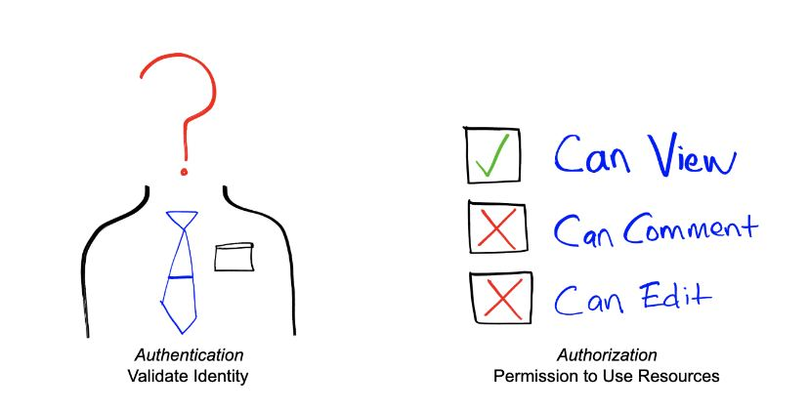
AUTHENTICATION
V/S
AUTHORIZATION
DONE BY:
PRAGATHI.M.I
PRAKRUTHI.M
RAMYA.C
SUBHASHREE.M

Slide 2
AUTHENTICATION
Authentication refers to the process of proving something to be true, genuine or valid.
In IT, authentication is the process of verifying someone’s identity with the purpose of controlling access to a protected resource.
Usually authentication is done by a username and password, although there are other various ways to be authenticated such as One-Time Password, authentication apps, and even biometrics.

Slide 3



AUTHENTICATION IN REAL LIFE
KNOW
ARE
HAVE

Slide 4
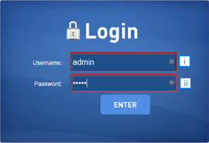

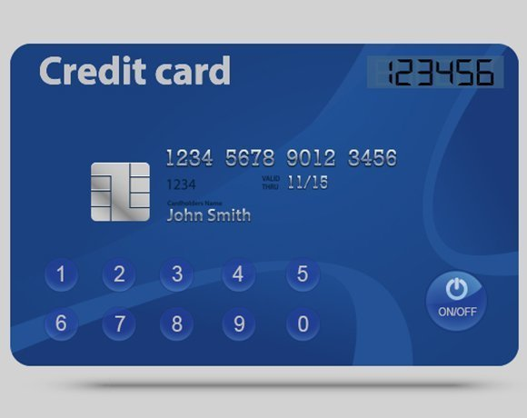
DIGITAL AUTHENTICATION
KNOW
ARE
HAVE

Slide 5
HOW SECURE ARE THEY ?

Slide 6
AUTHORIZATION
Authorization is a process by which a person(server) determines if the other person(client) has permission to use a resource or access a file. Authorization is usually coupled with authentication so that the server has some concept of who the client is that is requesting access.
In simple terms authorization is the process of verifying what you have access to.
Once your identity is verified by the system after successful authentication, you are then authorized to access the resources of the system.

Slide 7
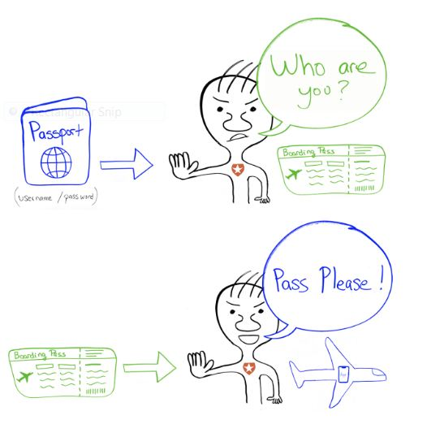
Let’s say you are traveling and you’re about to board a flight. When you show your ticket and some identification before checking in, you receive a boarding pass which confirms that the airport authority has authenticated your identity. But that’s not it. A flight attendant must authorize you to board the flight you’re supposed to be flying on, allowing you access to the inside of the plane and its resources.So we can conclude that even if the attempt is authenticated but not authorized then the system will deny access to the required data.

Slide 8
Transaction on e-commerce website
Let’s consider another example of authorization which is used during the process of retrieving data from the database.
We have 2 commands GRANT and REVOKE
The GRANT command is used for providing the authorization to the users inorder to select,insert,delete or update any value present in the database whereas REVOKE command is used for withdrawing the authorization.
GRANT SELECT, INSERT, UPDATE ON FACULTY, DEPARTMENT TO A1, A2;
GRANT SELECT, INSERT, UPDATE ON FACULTY, DEPARTMENT TO A1, A2;
REVOKE INSERT, UPDATE ON FACULTY, DEPARTMENT FROM A1, A2;

Slide 9
METHODS OF AUTHENTICATION

Slide 10
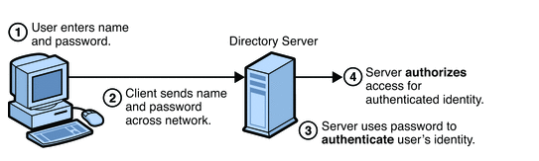
PASSWORD BASED AUTHENTICATION

Slide 11
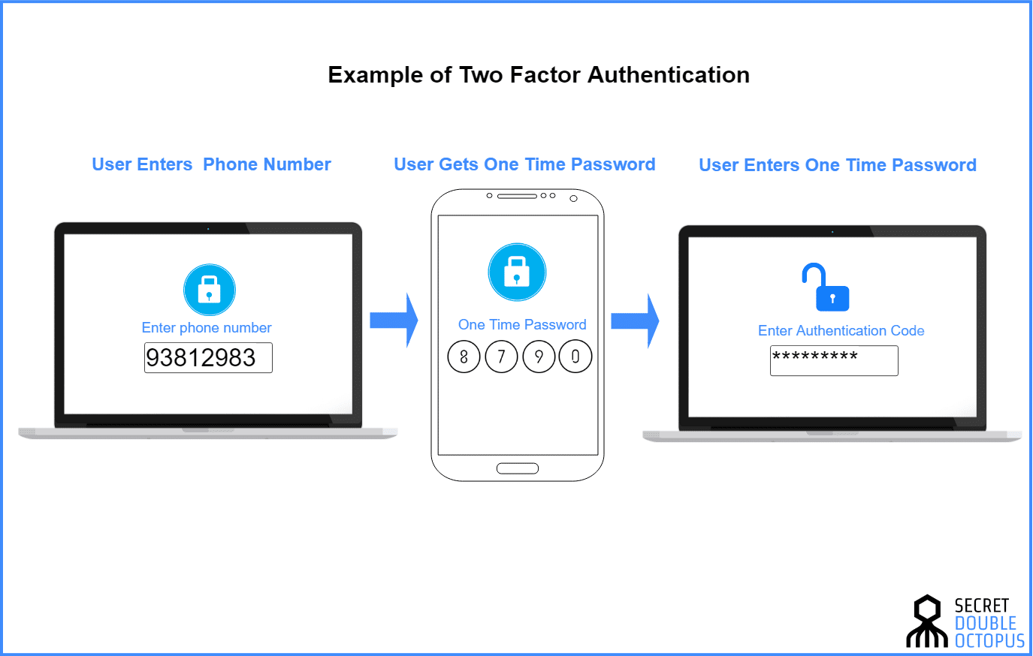
2. TWO FACTOR AUTHENTICATION (2FA)

Slide 12

3. BIOMETRIC AUTHENTICATION

Slide 13
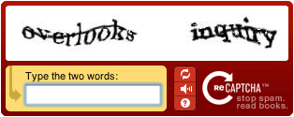
4. CAPTCHA

Slide 14
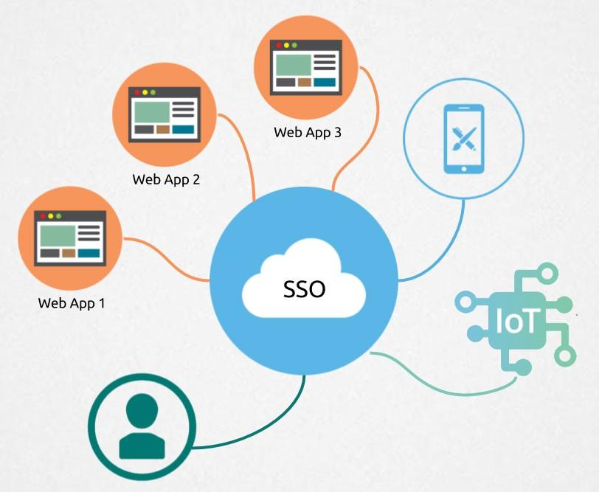
5. SINGLE SIGN ON (SoS)

Slide 15
METHODS OF AUTHORIZATION

Slide 16
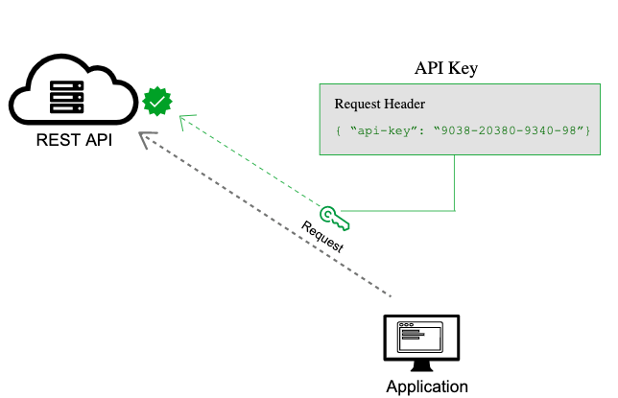
API KEYS

Slide 17

2. BASIC AUTH

Slide 18
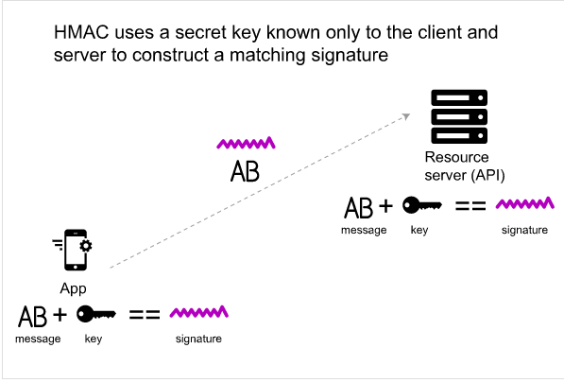
3. HASH BASED MESSAGE AUTHORISATION CODE (HMAC)

Slide 19
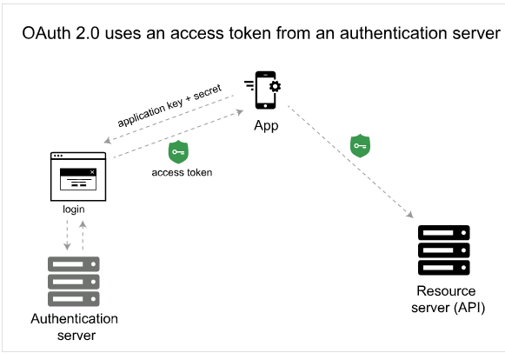
4. OAuth 2.0

Slide 20
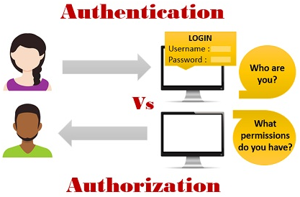
DIFFERENCES BETWEEN AUTHENTICATION & AUTHORIZATION

Slide 21
AUTHENTICATION
Authentication means confirming your own identity, in simple terms authentication is the process of verifying who you are.
It determines whether user is what he claims to be.
Authentication usually requires a username and a password.
AUTHORIZATION
Authorization means granting access to the system, in simple terms authorization is the process of verifying what you have access to.
It determines what user can and cannot access.
Authentication factors required for authorization may vary, depending on the security level.

Slide 22
AUTHENTICATION
Authentication is the first step of authorization so always comes first.
In authentication process, users or persons are verified.
For example, students of a particular university are required to authenticate themselves before accessing the student link of the university’s official website. This is called authentication.
AUTHORIZATION
Authorization is done after successful authentication.
While in this process, users or persons are validated.
For example, authorization determines exactly what information the students are authorized to access on the university website after successful authentication.

Slide 23
AUTHENTICATION
Authentication is important because it enables organizations to keep their networks secure by permitting only authenticated users to access its protected resources, which may include computer systems, networks, databases, websites and other network-based applications or services.
AUTHORIZATION
Authorization and permissions are essential.Authorization occurs with every request the user makes, starting with logging into their account. It's important that a company details the type of permissions that apply to both users and staff members so that accounts don't have more capabilities than they need.

Slide 24
THANK
YOU

